Slide 1


c
INCREDIBLE
INSTALLATIONS
QUALITY, WITHOUT COMPROMISE

Slide 2
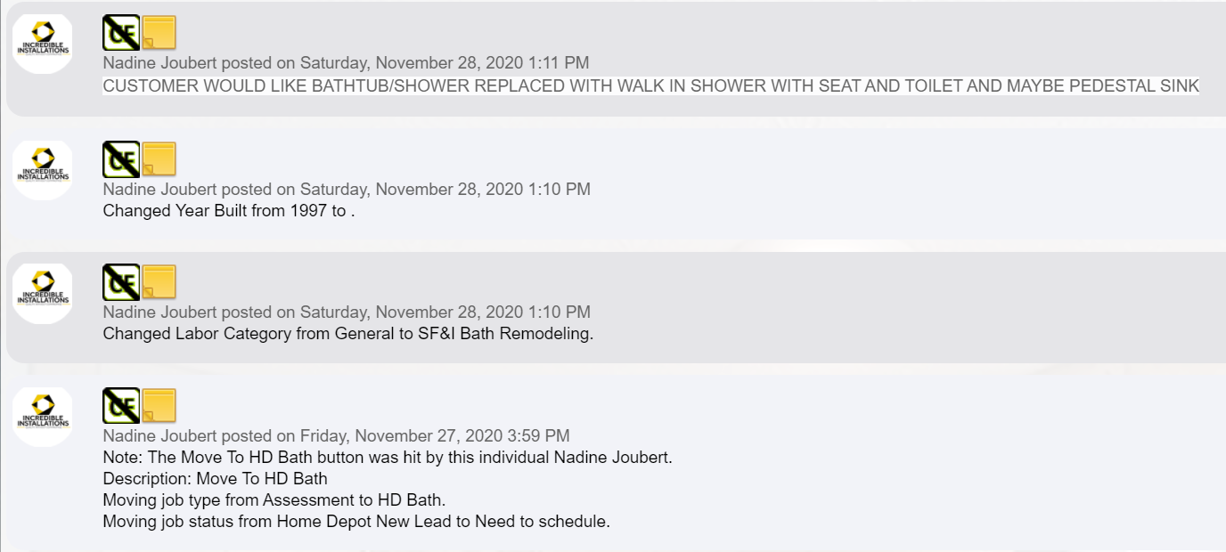
Incredible Installations – Robert Hay Sale Cycle – Lead Processing

Slide 3
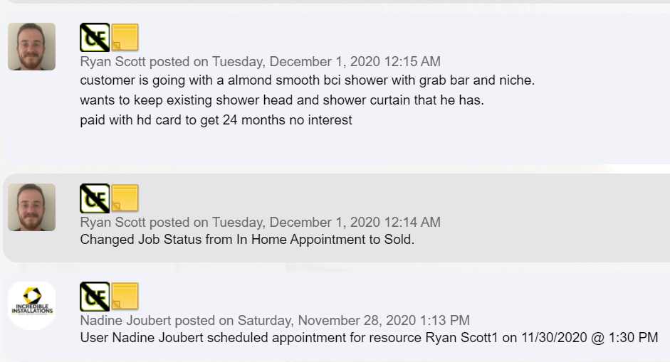
Incredible Installations – Robert Hay Sale Cycle – Lead to Scheduled

Slide 4
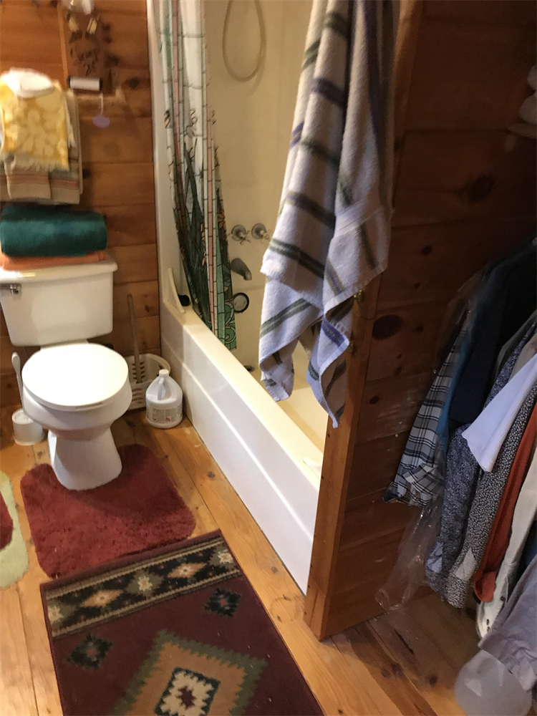
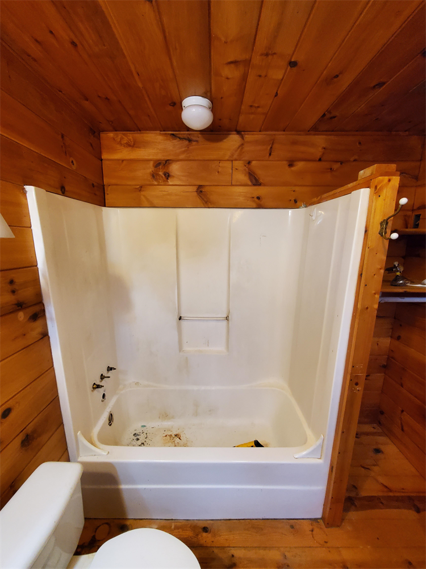
Incredible Installations – Robert Hay Sale Cycle – Before Pictures

Slide 5
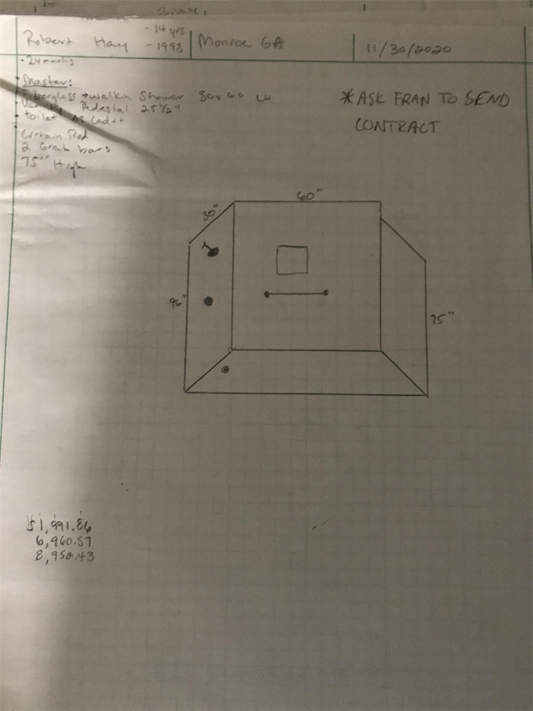
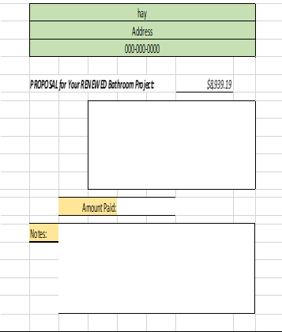
Incredible Installations – Robert Hay Sale Cycle – In Home Drawing and Estimator

Slide 6
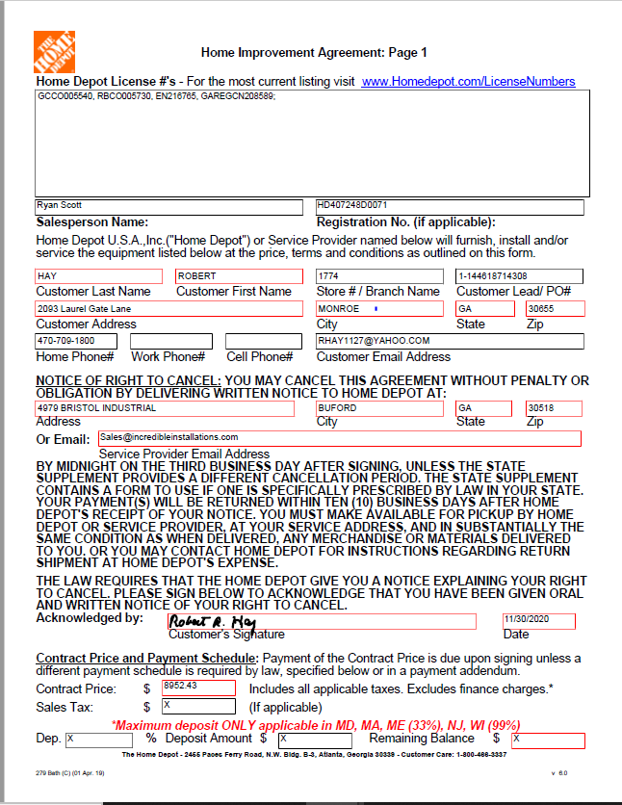
Incredible Installations – Robert Hay Sale Cycle – Signed Contract Hay

Slide 7
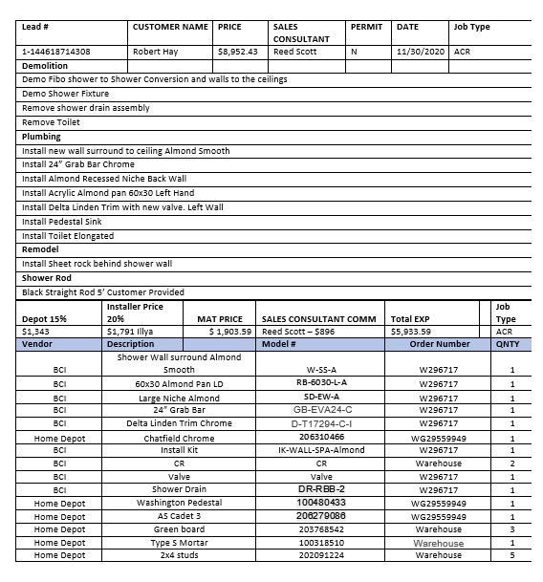
Incredible Installations – Robert Hay Sale Cycle – Scope and Product Order Sheet

Slide 8
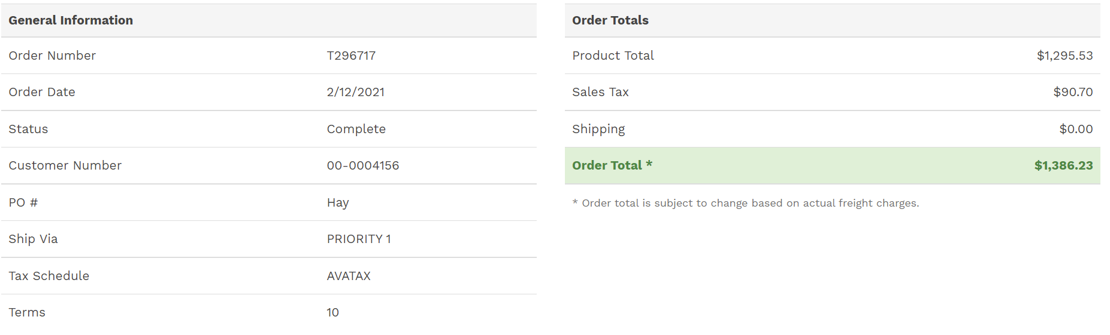
Incredible Installations – Robert Hay Sale Cycle – Order Placed
BCI Order Delivered 2/20/21.

Slide 9
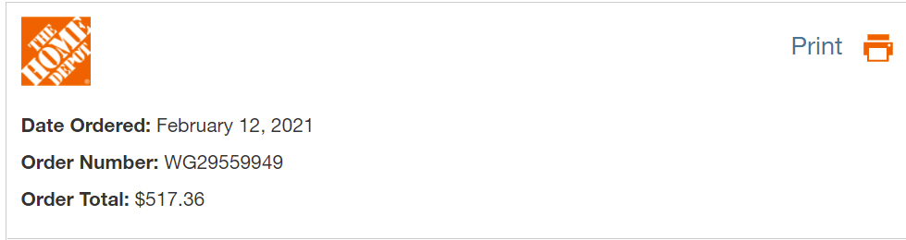
Incredible Installations – Robert Hay Sale Cycle – Order Placed
HD Order.

Slide 10
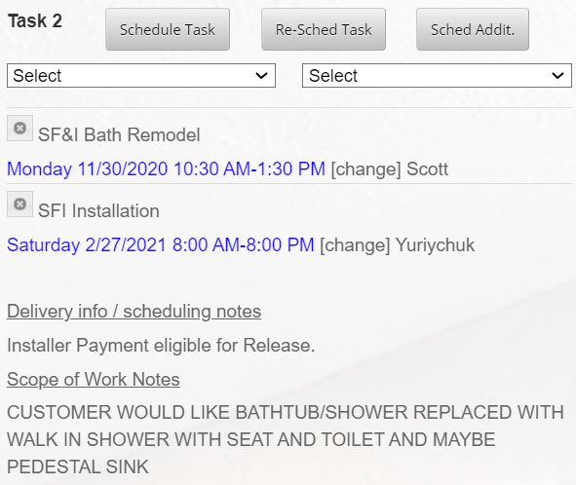
Incredible Installations – Robert Hay Sale Cycle – Project Start
Installation Start and Finish 2/27/2021

Slide 11
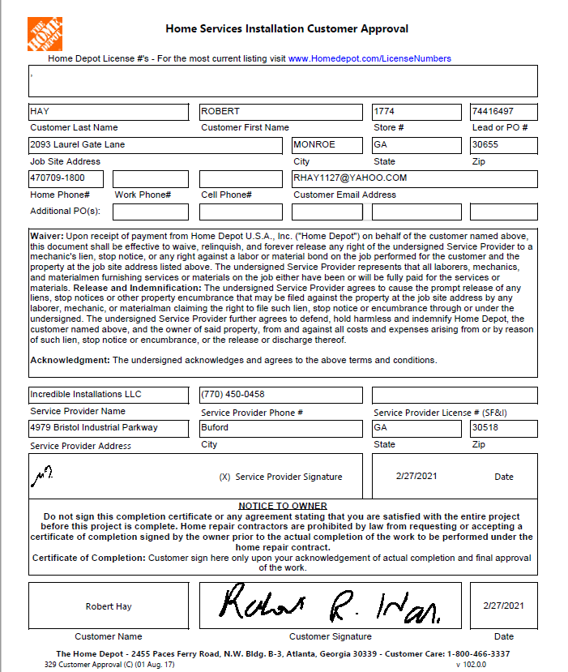
Incredible Installations – Robert Hay Sale Cycle – Customer COC
Installation Start and Finish 2/27/2021

Slide 12
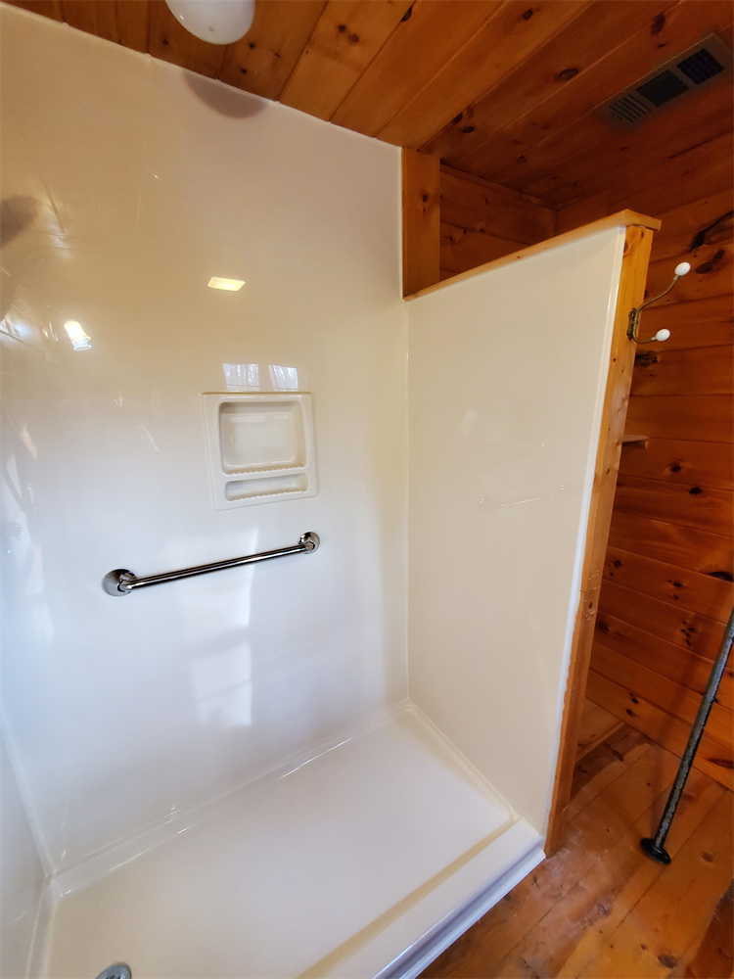
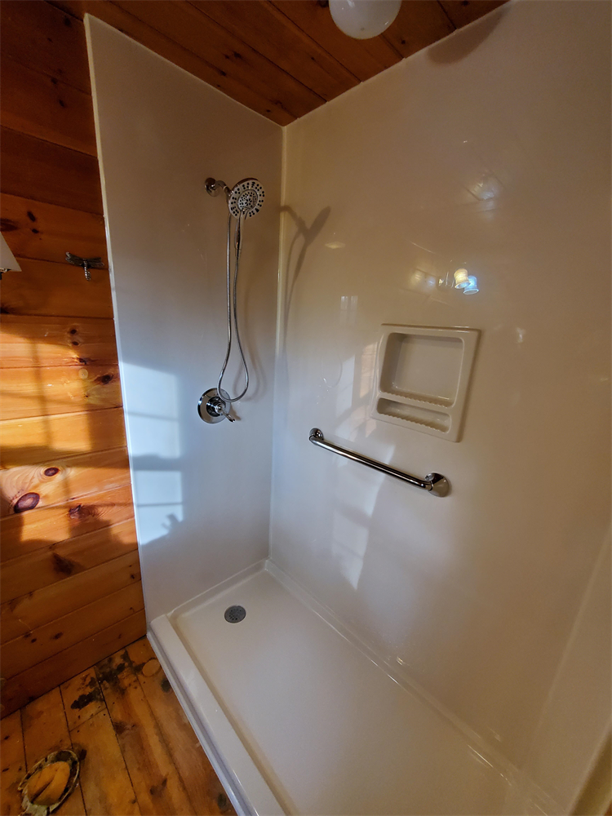
Incredible Installations – Robert Hay Sale Cycle – After Pics

Slide 13
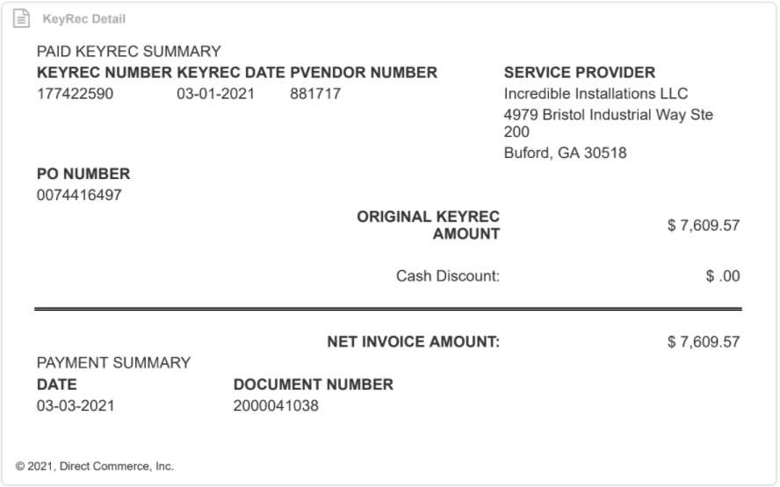
Incredible Installations – Robert Hay Sale Cycle – Payment Received

Slide 14
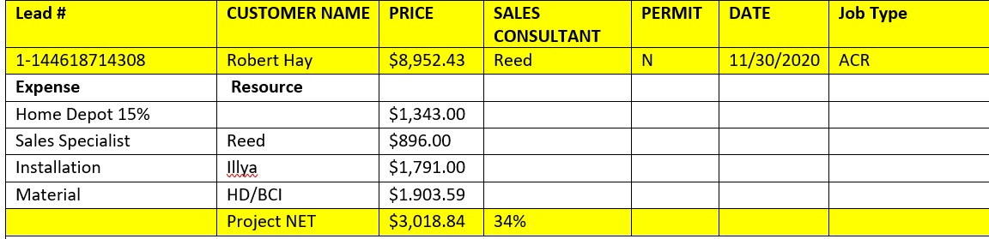
Incredible Installations – Robert Hay Sale Cycle – Reconciled Job Break Down

